Slide 1

Home
What, why, how?
Data
Everything else
Home
This site is to help people make sense of the published survival statistics about children’s heart surgery. Our website will help you:
explore what survival rates can and can’t tell you
understand how the NHS monitors children’s heart surgery
explore published results for UK hospitals
Use the tabs or watch our animations to explore this site!
ANIMATION: SITE NAVIGATION/INTRO?
WHAT, WHY, HOW?
DATA
EVERYTHING ELSE!
What do we mean by survival statistics?
Why are survival statistics after children’s heart surgery hard to interpret?
How does the NHS monitor them?
Explore published survival statistics!
Use the illustration to see how we present the statistics.
Browse hospitals on a UK map
Get an overview of all hospitals in a list
More information about how survival statistics are monitored
What happens if there are any concerns about the data?
More information about us, this website and external resources.
Plus lots of other information!
FOOTER: NIHR disclaimer/logos of who we are/ link to page “about us/contact”

Slide 2
Home
What, why, how?
Data
Everything else
What, why, how?
KEY POINTS!
If one hospital has a higher survival rate than another hospital it does not mean that it is better than the other!
The predicted range is calculated by a formula and does not depend on any judgements of a hospital’s quality!
The survival rate for all UK hospitals is very high.
WHAT do we mean by survival statistics?
The main measure that the NHS uses to monitor children’s heart surgery in the UK is the 30-day survival rate. This is the percentage of operations where the child survived at least 30 days after their heart surgery (e.g. 100% would mean that every child survived). Currently, about 3500 children under the age of 16 have heart surgery each year in the United Kingdom and Republic of Ireland.
+ ANIMATION ON SURVIVAL AND RISK AND PREDICTED RANGES
WHY can survival rate data be difficult to interpret?
Add text from existing site
HOW the NHS monitors survival rates : a fairer way of looking at the data:
Add text from existing site
This site will be particularly helpful for: older patients, parents and families of children who have had/will have heart surgery; journalists, parents, health professionals, family liaison services of paediatric hospitals.
What this site cannot do
Add text from current site
FOOTER: NIHR disclaimer/logos of who we are/ link to page “about us/contact”

Slide 3
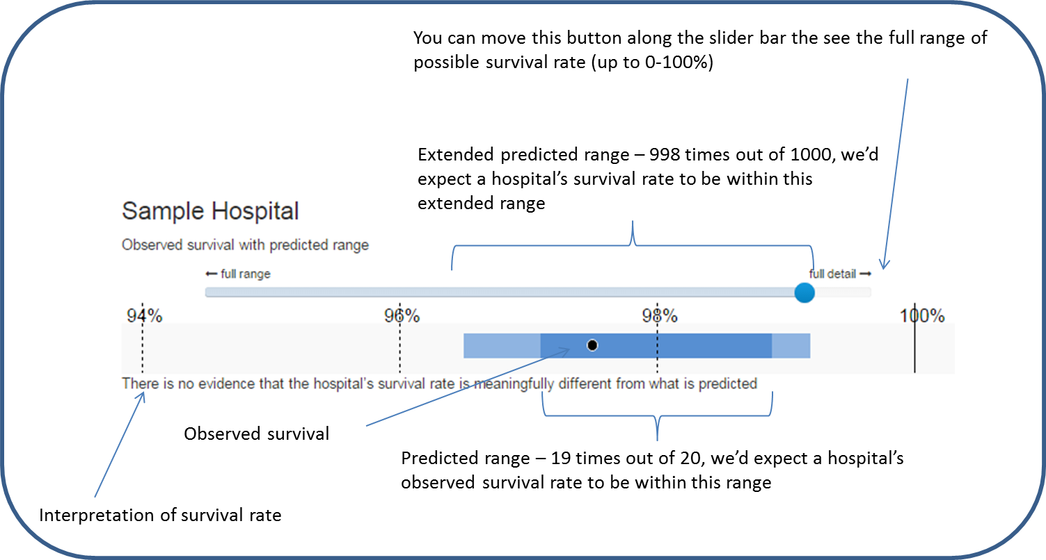
Home
What, why, how?
Data
Everything else
Explore the data
View published data in a MAP or a LIST
We present each hospital’s observed survival in the context of its predicted range – see illustration below
+ ANIMATION ON HOW TO READ THE DATA
IMPORTANT: If one hospital has a lower predicted range than another it is only because it treated children with more complex medical problems over that 3 year period!
FOOTER: NIHR disclaimer/logos of who we are/ link to page “about us/contact”

Slide 4
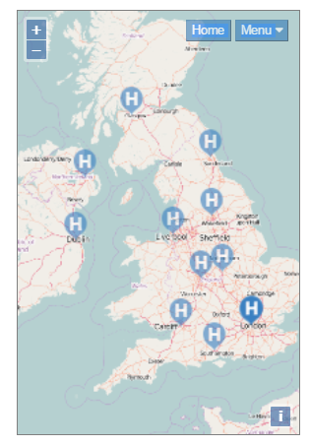
Home
What, why, how?
Data
Everything else
Explore the data
View published data in a LIST or return to illustrative example
Mapped data for April 2011 – March 2014
There are fourteen hospitals in the UK and Ireland that perform heart surgery in children (0-16 years old).
This data is updated annually and covers the most recent 3 year report period.
To see all hospitals together or to see previous reporting periods, visit the List page.
Use the “Home” button on the map to return to the full UK view.
Either click on the relevant “H” button or use the menu to see results and information for a specific hospital.
You can use your mouse to hover over features of the data to get more explanation.
An explanation for how the predicted ranges are calculated see the “What, why how” page, with further information available in the “Everything else” page.
FOOTER: NIHR disclaimer/logos of who we are/ link to page “about us/contact”

Slide 5
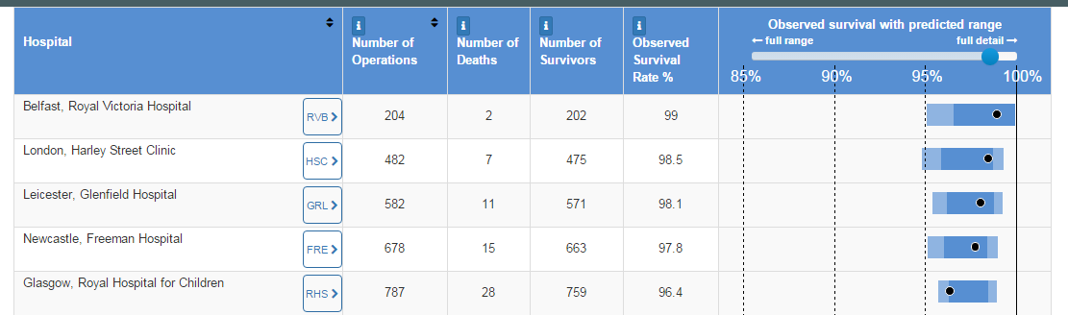
Home
What, why, how?
Data
Everything else
Explore the data
View published data on a MAP or return to illustrative example
List data for April 2011 – March 2014
There are fourteen hospitals in the UK and Ireland that perform heart surgery in children (0-16 years old).
This data is updated annually and covers the most recent 3 year report period.
Previous reporting periods can be selected at the bottom of the table.
Clicking on a hospital code will bring up specific information for that hospital along with an interpretation of its survival rate.
You can use your mouse to hover over the displayed data to bring up more explanation.
FOOTER: NIHR disclaimer/logos of who we are/ link to page “about us/contact”

Slide 6
Home
What, why, how?
Data
Everything else
Everything else!
This page contains more detailed information on:
Background to children’s heart surgery results
Understanding the predicted range
Limitations of these results and the data
My family or child
Who developed this site and how?
Further resources about understanding clinical data
Background to children’s heart surgery results
Why do some children need heart surgery?
Where does the survival data come from?
Why are survival data monitored and published?
FOOTER: NIHR disclaimer/logos of who we are/ link to page “about us/contact”

